Slide 1
Key Value Storage Engines
Demetris Kaizer
EPL646 Advanced Topics in Databases

Slide 2
Topics
01
02
03
STATE OF THE ART ENGINE DESIGN
SELF-DESIGNED NOSQL STORAGE
KEY-VALUE STORAGE ENGINES INTRODUCTION
B⁺ Tree
Log-Structured Merge Tree
Log and Index
Memory management
Concurrency Control
CPU vs I/O cost

Slide 3
01. Key Value Store

Slide 4
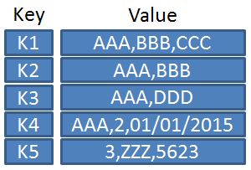
Key-Value Store Introduction

Slide 5
Key Value Stores
Stand alone NoSQL systems
Machine Learning
Relational Systems
Usages

Slide 6
02. State of the Art Engine Design

Slide 7
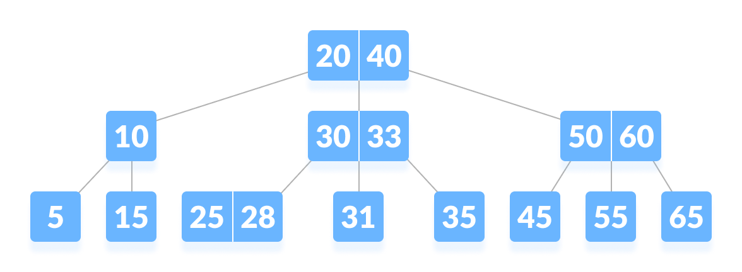
B+ Tree
B⁺tree design
Leaf level of independent nodes sorted key-value pairs
Index (logarithmic at the number of leaf nodes)

Slide 8
B+ Tree Characteristics
Characteristics:
Good balance between read and write performance
Reasonable memory overhead
Due to its fill factor in each node (typically 50%)
Examples:
WiredTiger
MongoDB
FoundationDB

Slide 9
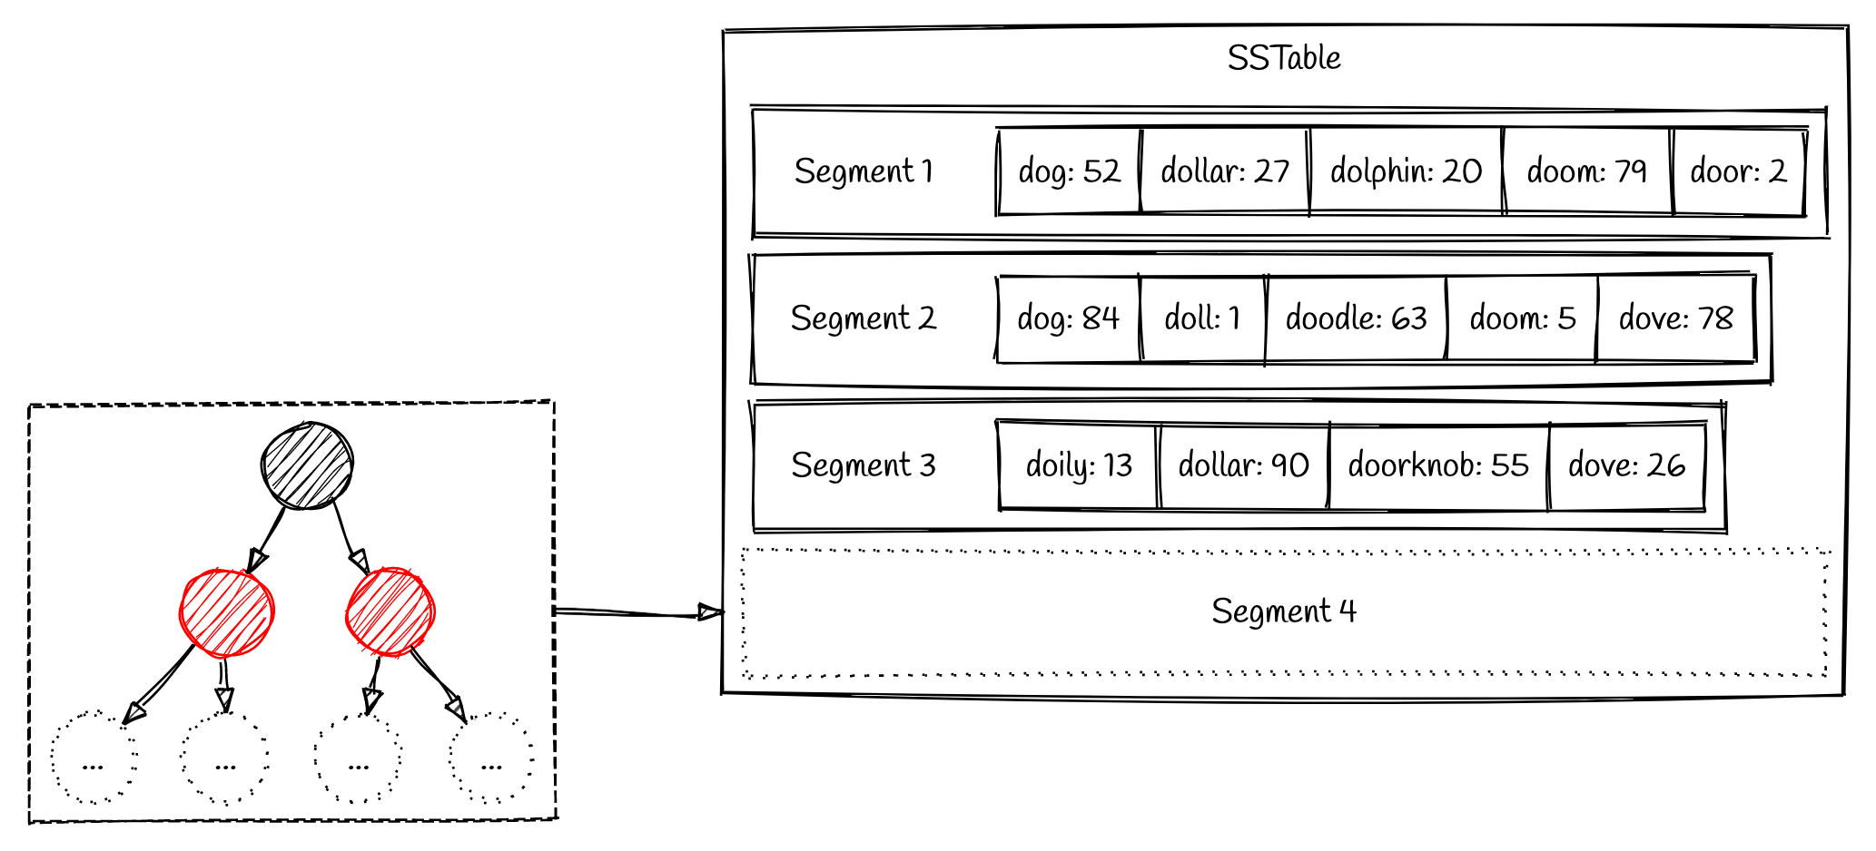
Log Structure Merge Tree (LSM)
Buffering new data in memory, batching writes in secondary storage
Each key-value entry enters at the very top level (the in-memory write buffer) and is sort-merged at lower levels as more data arrives.
Bloom filters, fence pointers and Tries help filter queries to avoid disk I/O

Slide 10
Log Structure Merge Tree (LSM) Characteristics
Characteristics:
Better write than B+ trees
Give up some read performance (example range queries) [look data through multiple levels]
Memory applification to hold enough in memory to support fast queries
Examples:
LevelDB
BigTable
Cassandra

Slide 11
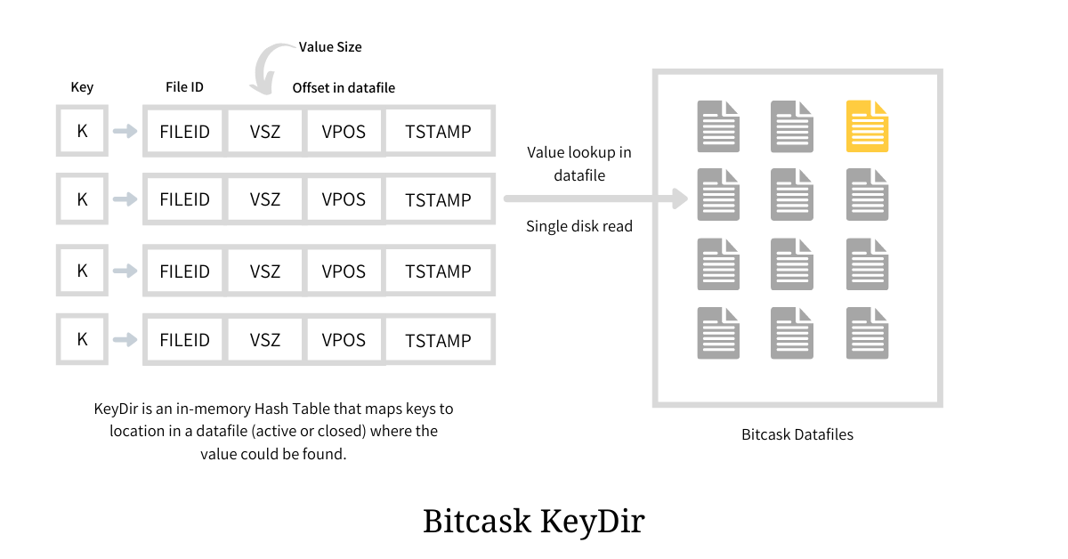
Log and Index

Slide 12
Log and Index Characteristics
Characteristics
Excellent write performance.
Sacrifices read performance (for range queries).
Memory footprint is higher since now all keys need to be indexed in-memory.
Examples:
BitCask
Sparkley
Faster

Slide 13
Concurrency Control
We need to be able to support concurent read/write queries.
LSM-Trees vs B+ Trees
LSM are better because the update data out of place.
Log-structured hash table
Goes a step further by performing much fewer compactions and thus creating fewer conflicts for reads and writes.

Slide 14
CPU vs I/O Cost
There is a balance between I/O Cost and CPU
Example:
Using compression leads to higher CPU cost but lower I/O – disk space usage.

Slide 15
Trade offs
CPU
I/O
Read Performance
Write Perfomance

Slide 16
Adaptive Indexing and Layouts
A way to blend performance properties.
Reacts to workload changes by building or refining indices partially and incrementally as part of query processing. (adaptivity)
Recently this area has received considerable attention with numerous works that study adaptivity with regards to base storage in relational systems and NoSQL Systems.

Slide 17
03. SELF-DESIGNED NOSQL STORAGE

Slide 18
Self Designed System
A self-designed system uses the design space to automatically generate designs that fit best a target workload and hardware.
Learned cost models is a method that enables learning the costs of fundamental access patterns. (random access, scan, sorted search)
Machine learning algorithms that iterate over machine generated data structure specifications to label designs, and to compute rewards, deciding which specification to try out next.

Slide 19
Design continuums
Allows for accurate fast search for the best design.
A design continuum is a performance hyperplane that connects a specific subset of designs within the set of all possible designs.

Slide 20
Applications: Big Data, Data Science.
COSTS
DATA
Need to process ever growing amounts of data.
Even the slightest sub optimality in these decisions can cost anything from hours to days in processing.
STORAGE
Data storage and exact processing algorithms supported need to vary depending on the exact access patterns desired by the high level algorithms/workloads.

Slide 21
Tutorial Writers
Stratos Idreos an associate professor of Computer Science at Harvard University where he leads the Data Systems Laboratory.
Mark Callaghan is a Distinguished Engineer at MongoDB and works on database performance.

Slide 22
Thank you!

